Slide 1
Joints and Structures
in Mylar (Dura-Lar)
Molly Morin
@MollyCMorin

Slide 2
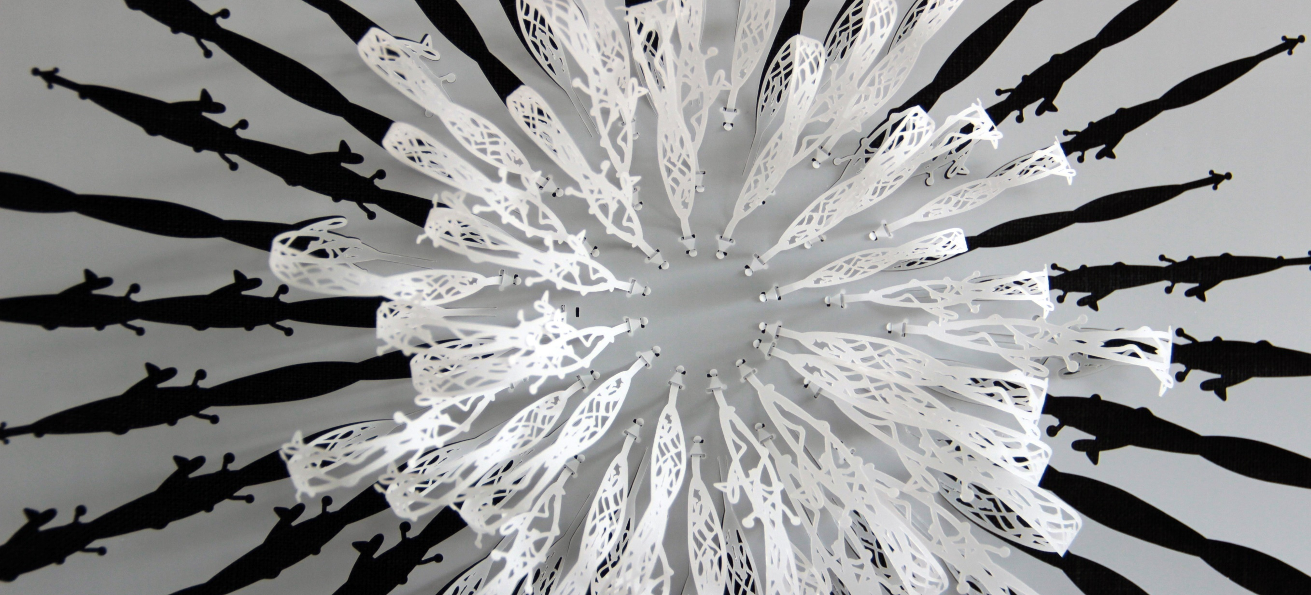

Slide 3
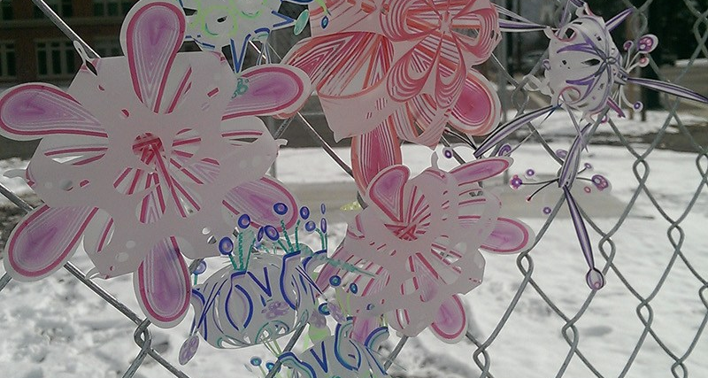
Molly Morin, Programming for People, 2017

Slide 4
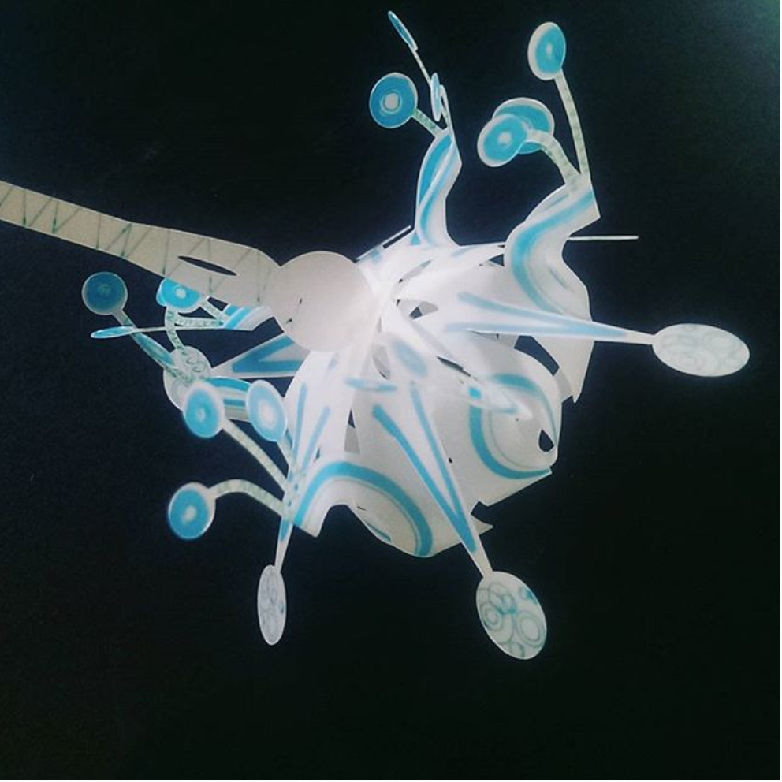

Slide 5
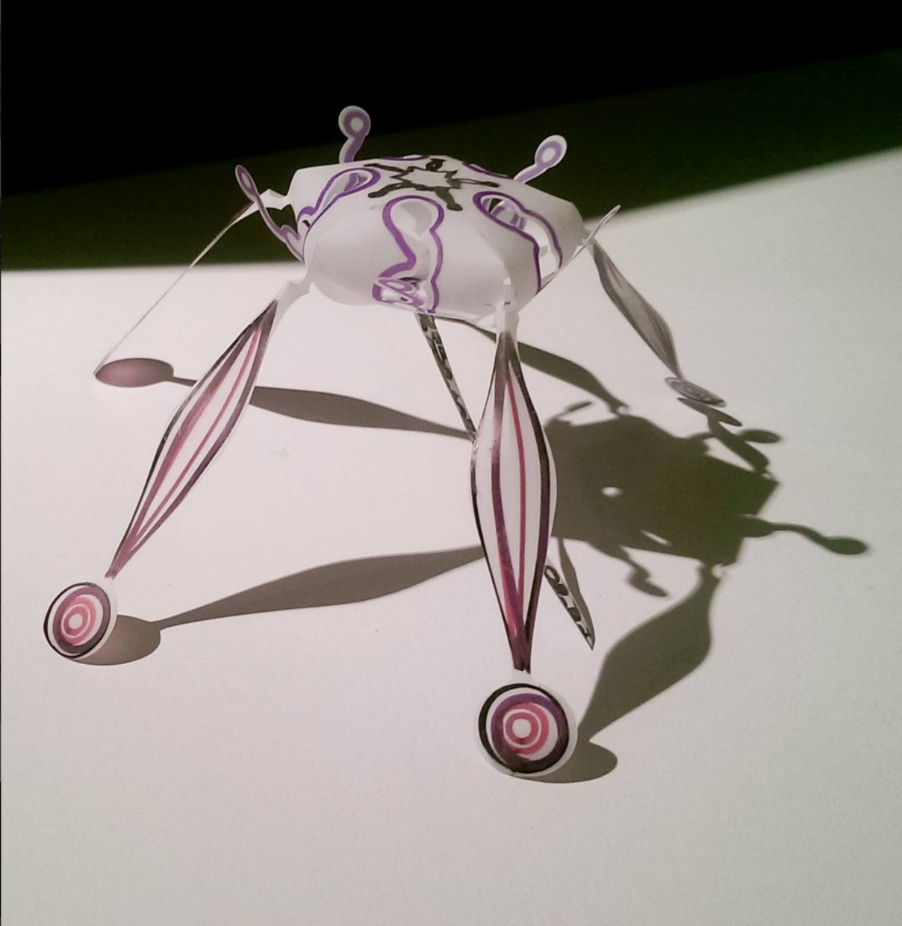

Slide 6
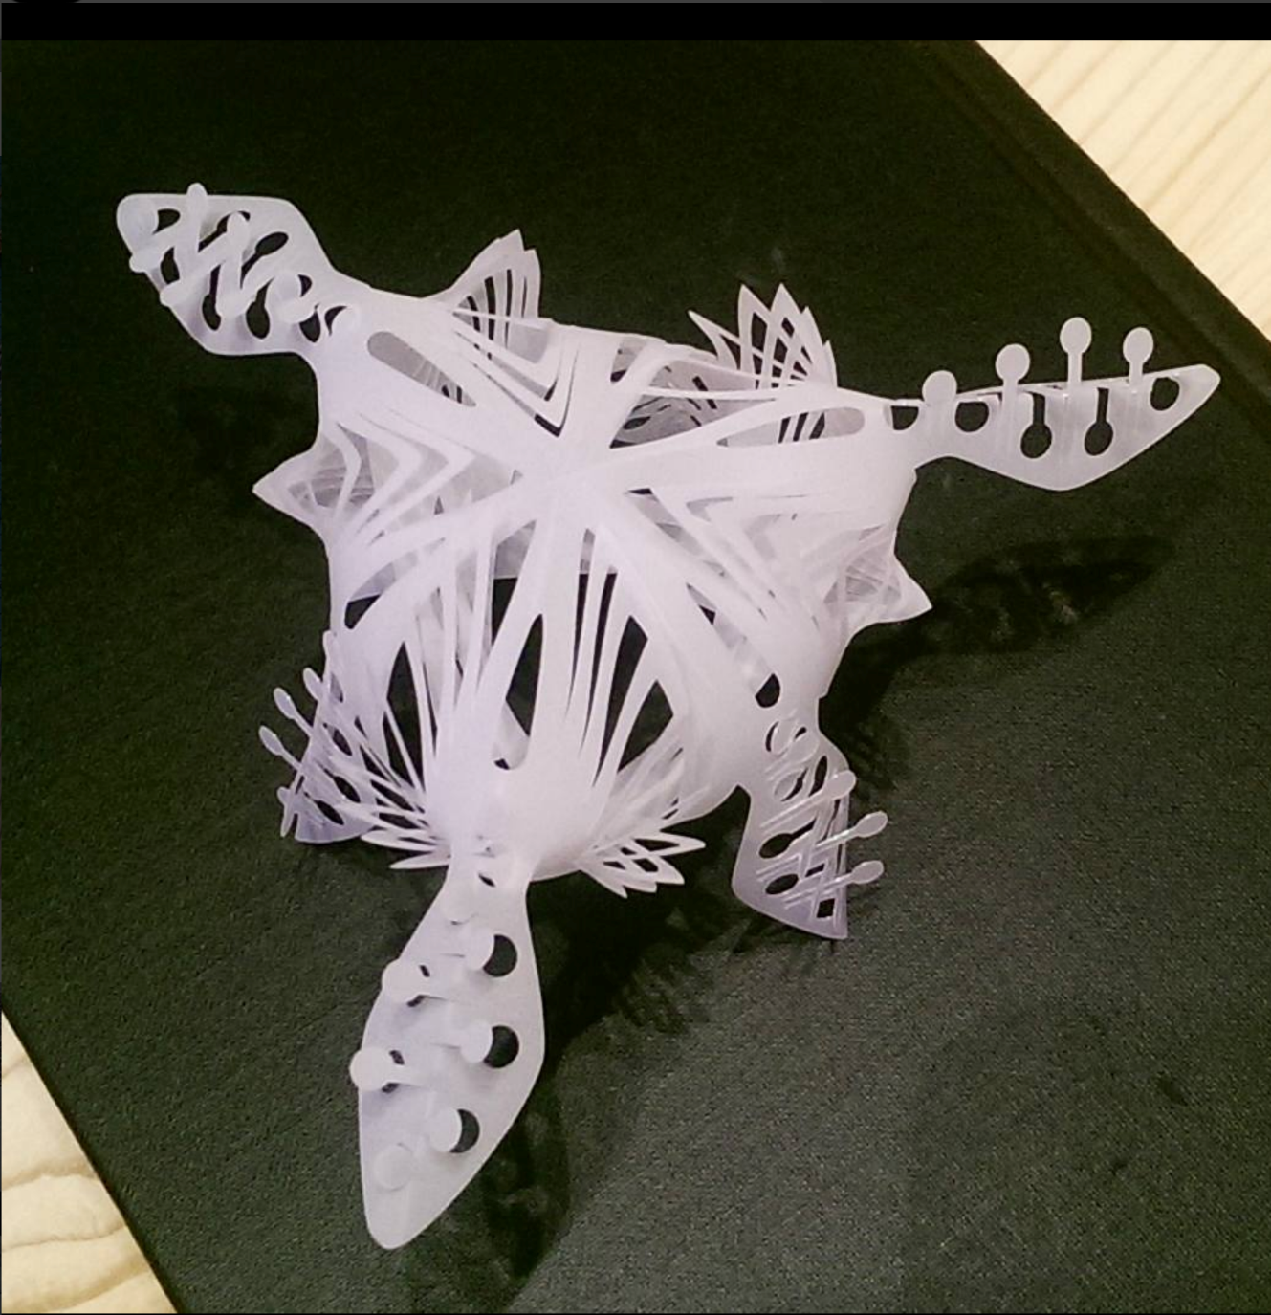

Slide 7
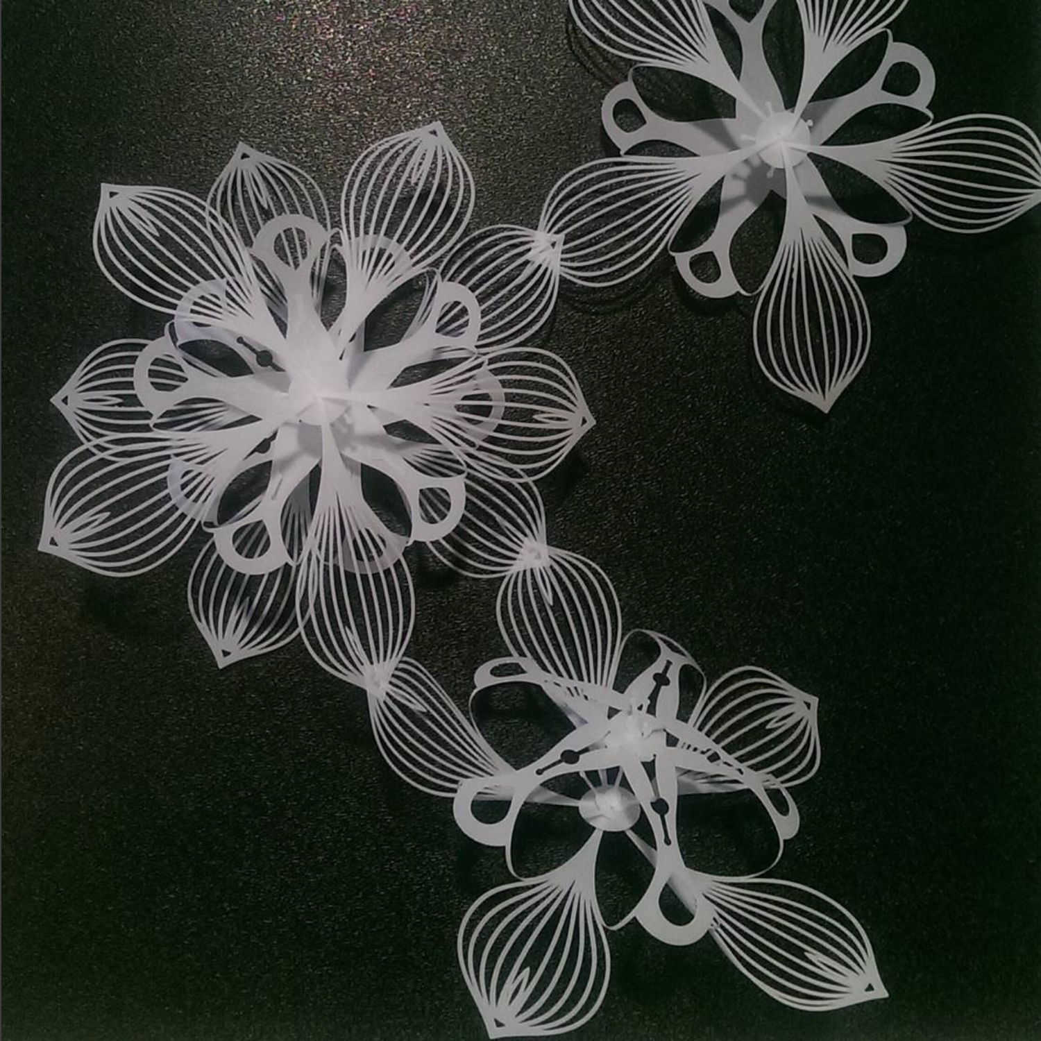

Slide 8
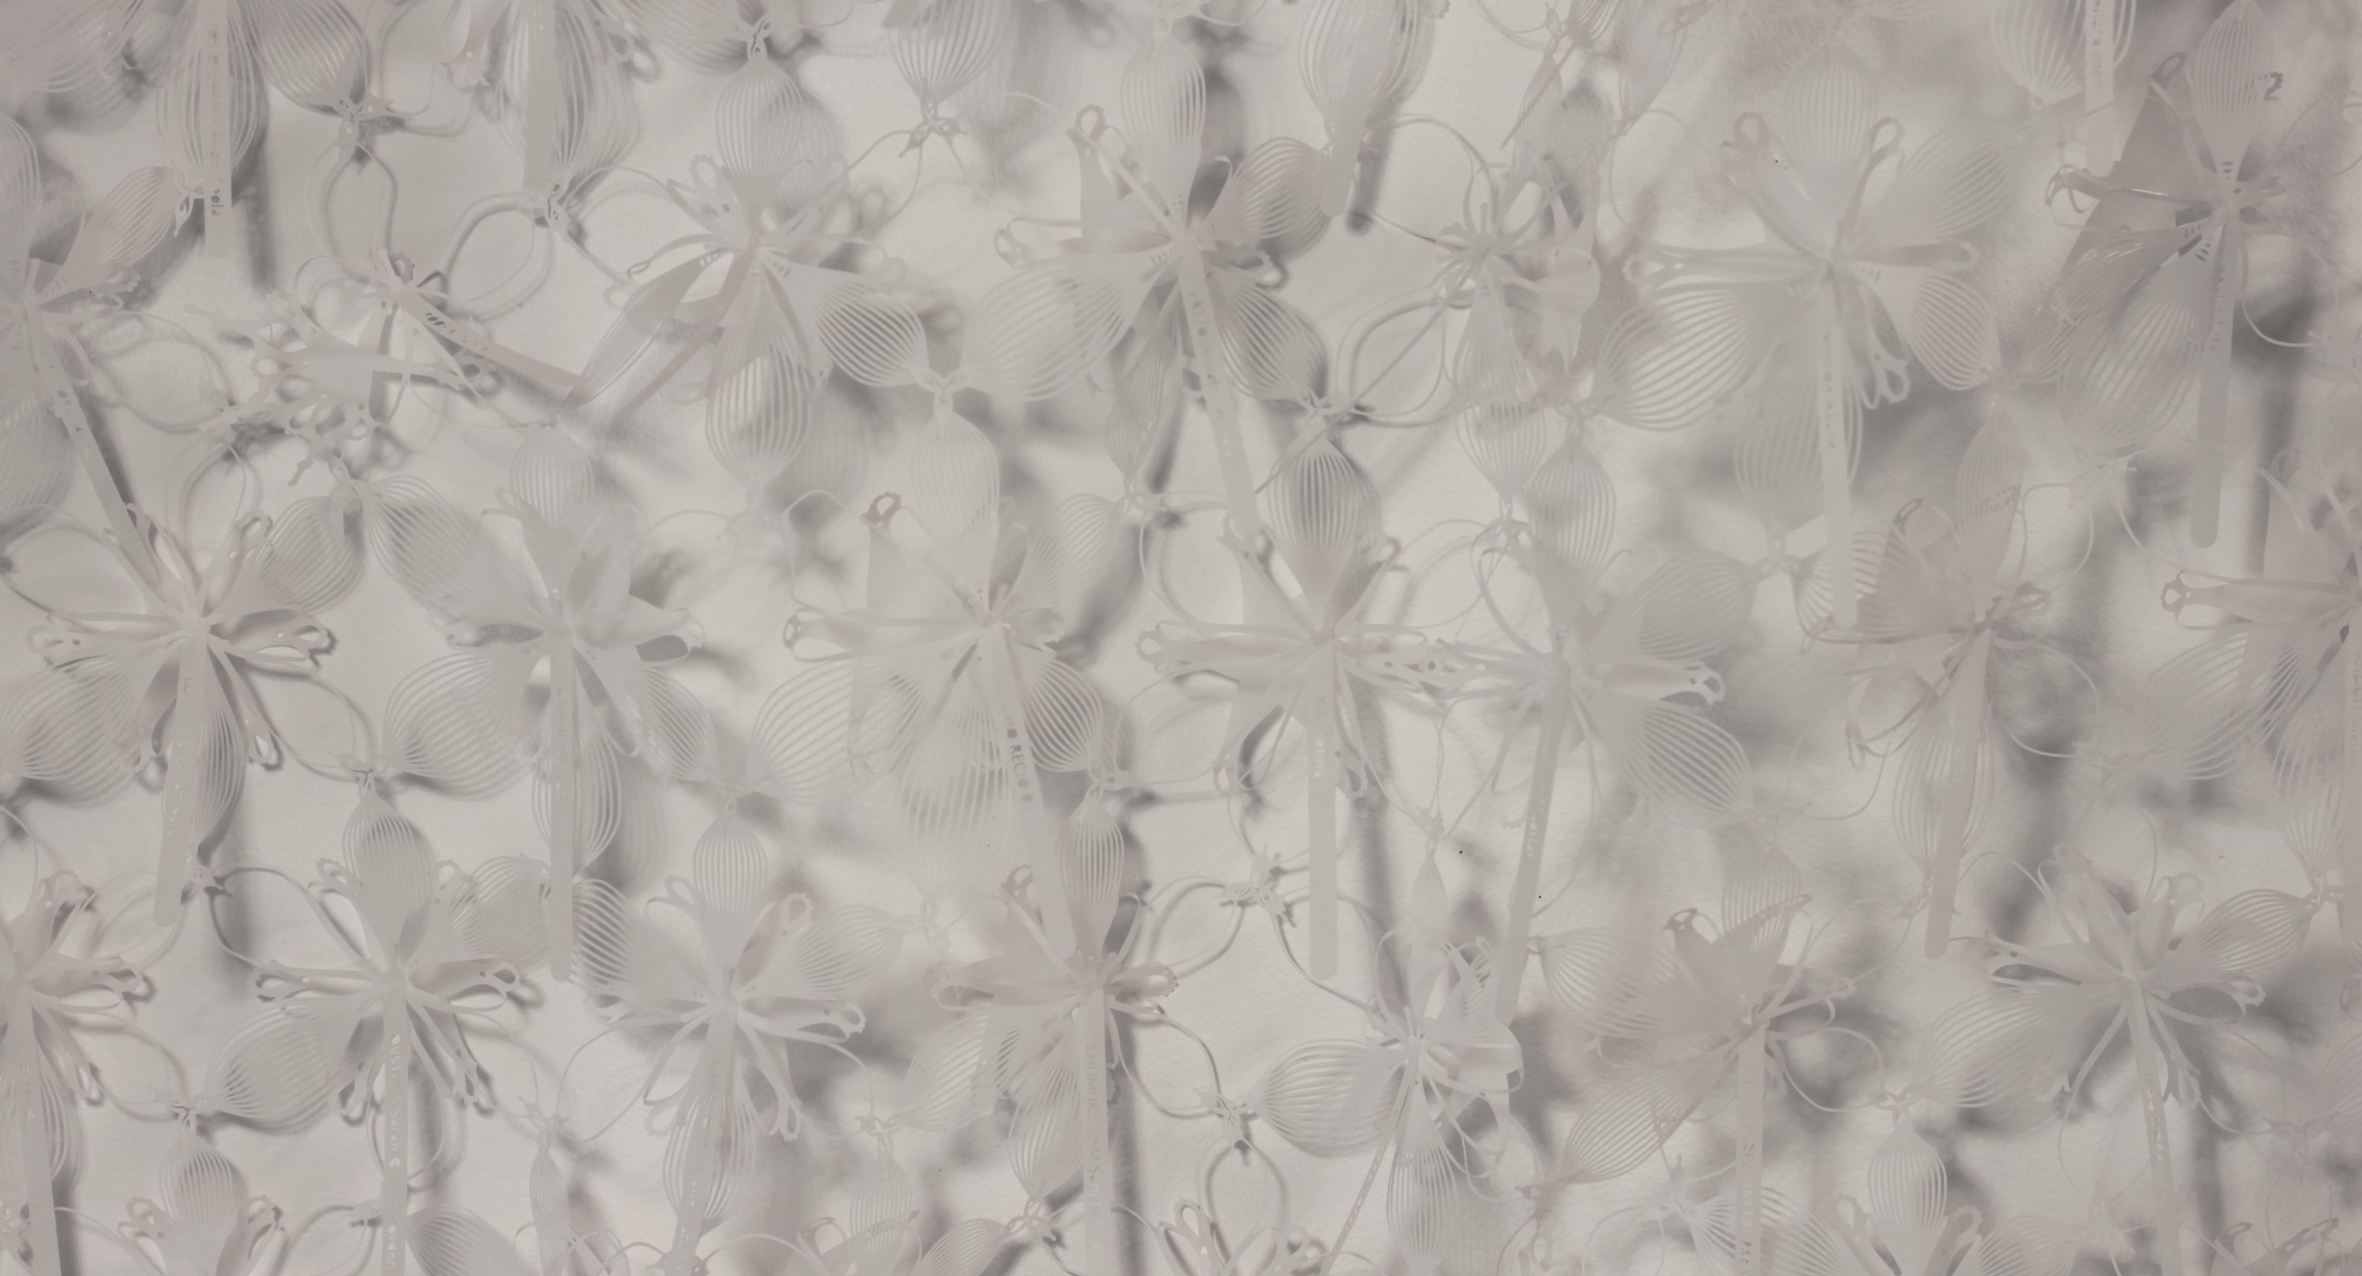
Molly Morin, Every Attempt, 2018

Slide 9
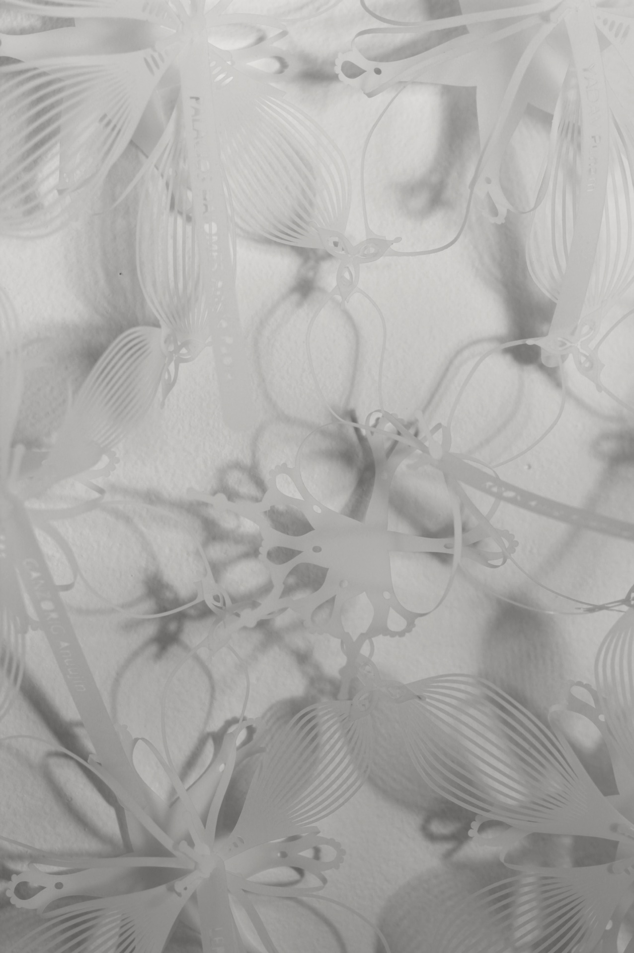
Molly Morin, Every Attempt, 2018

Slide 11
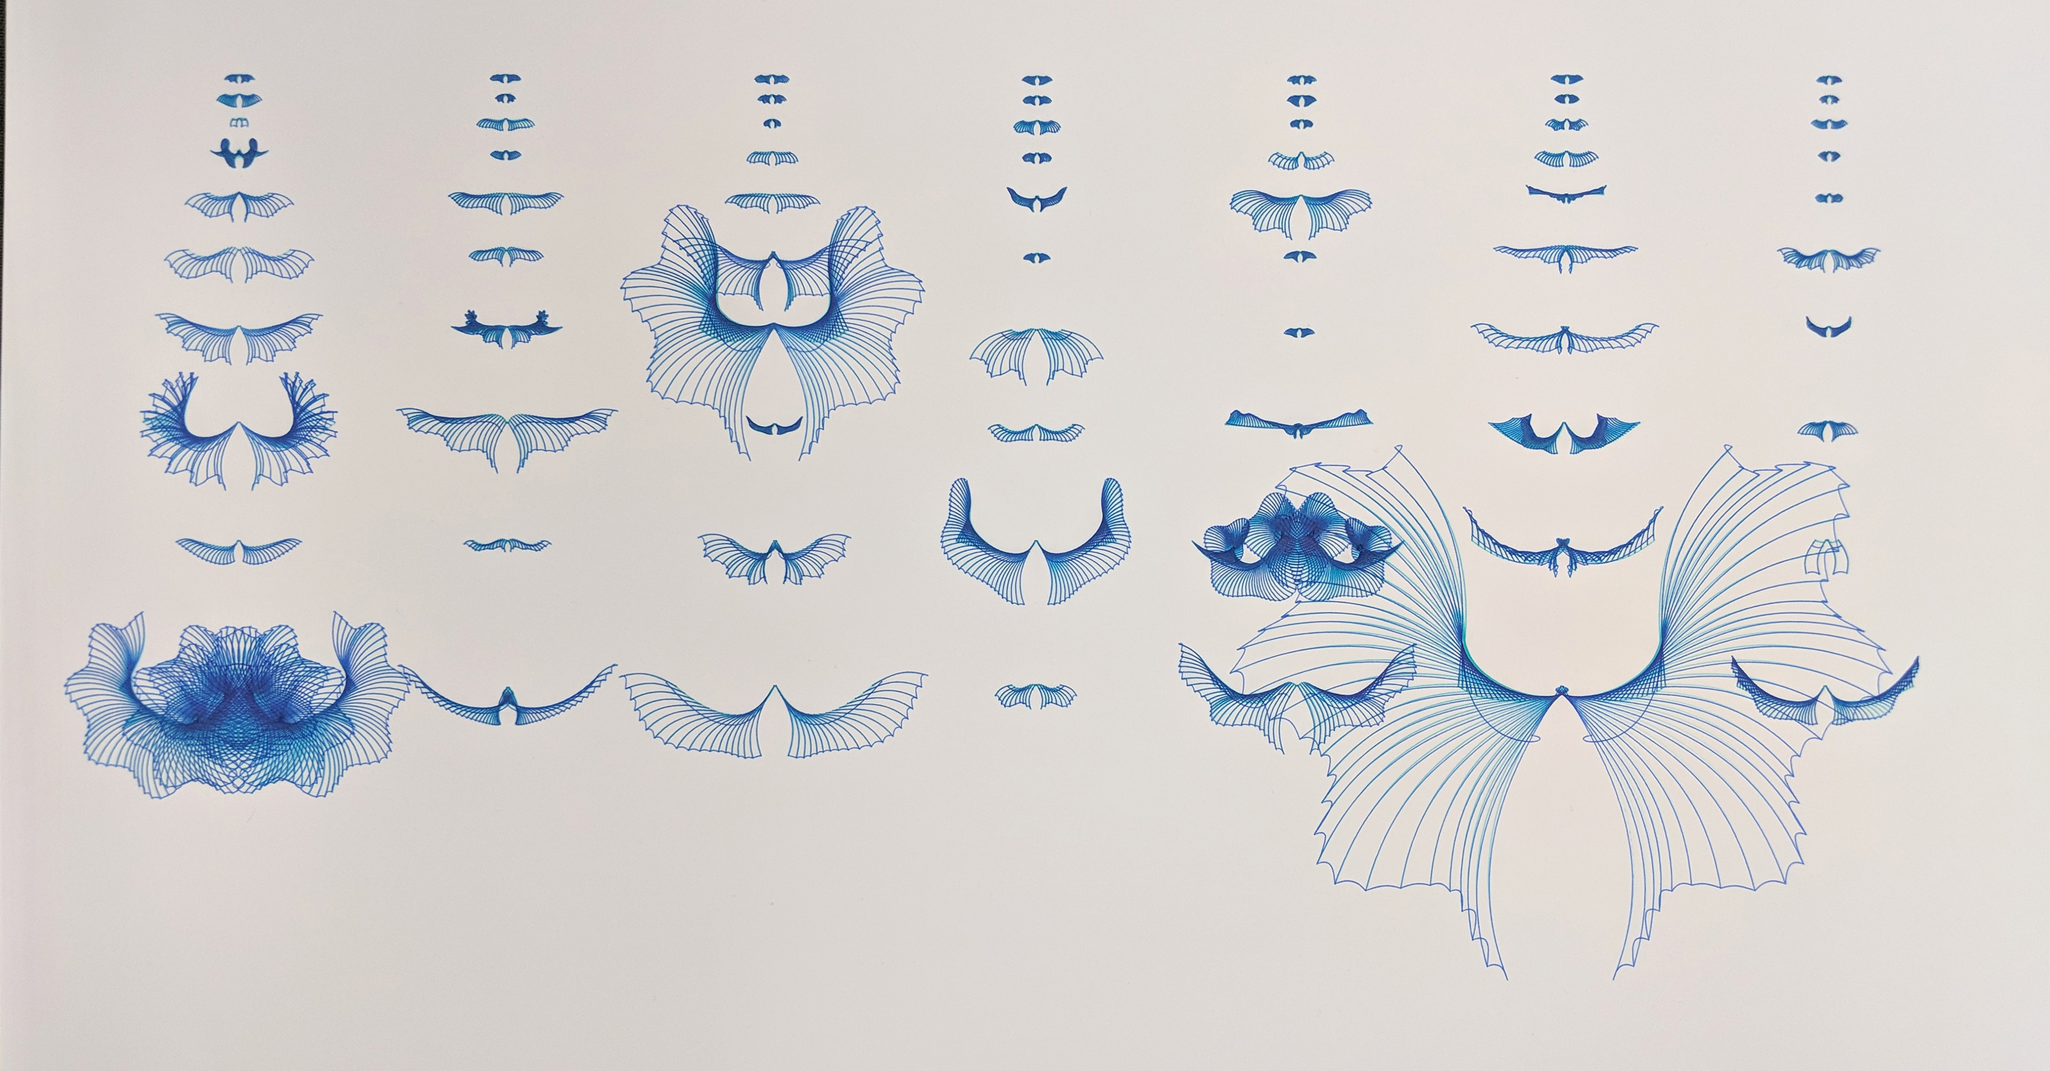
Molly Morin, Mutants, 2018

Slide 12
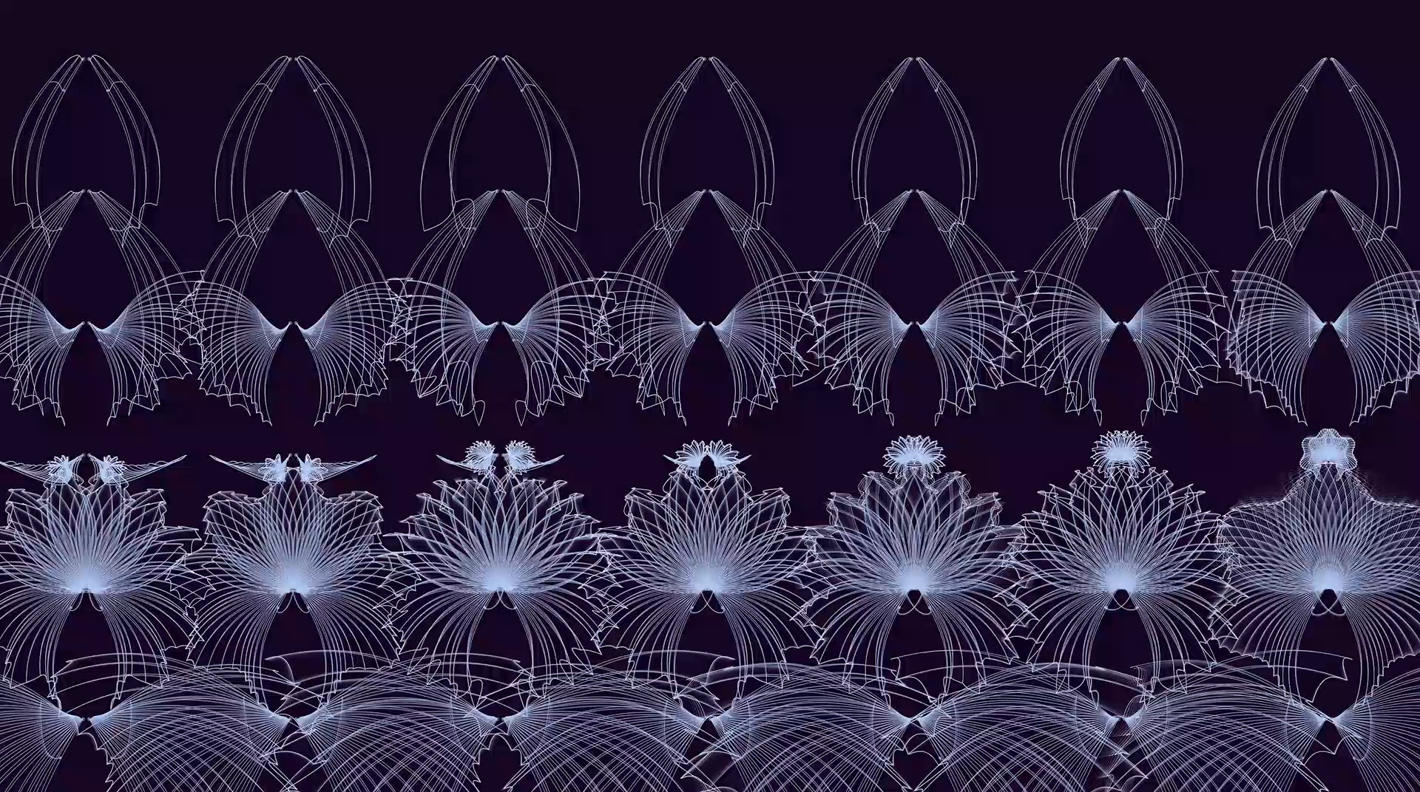

Slide 13
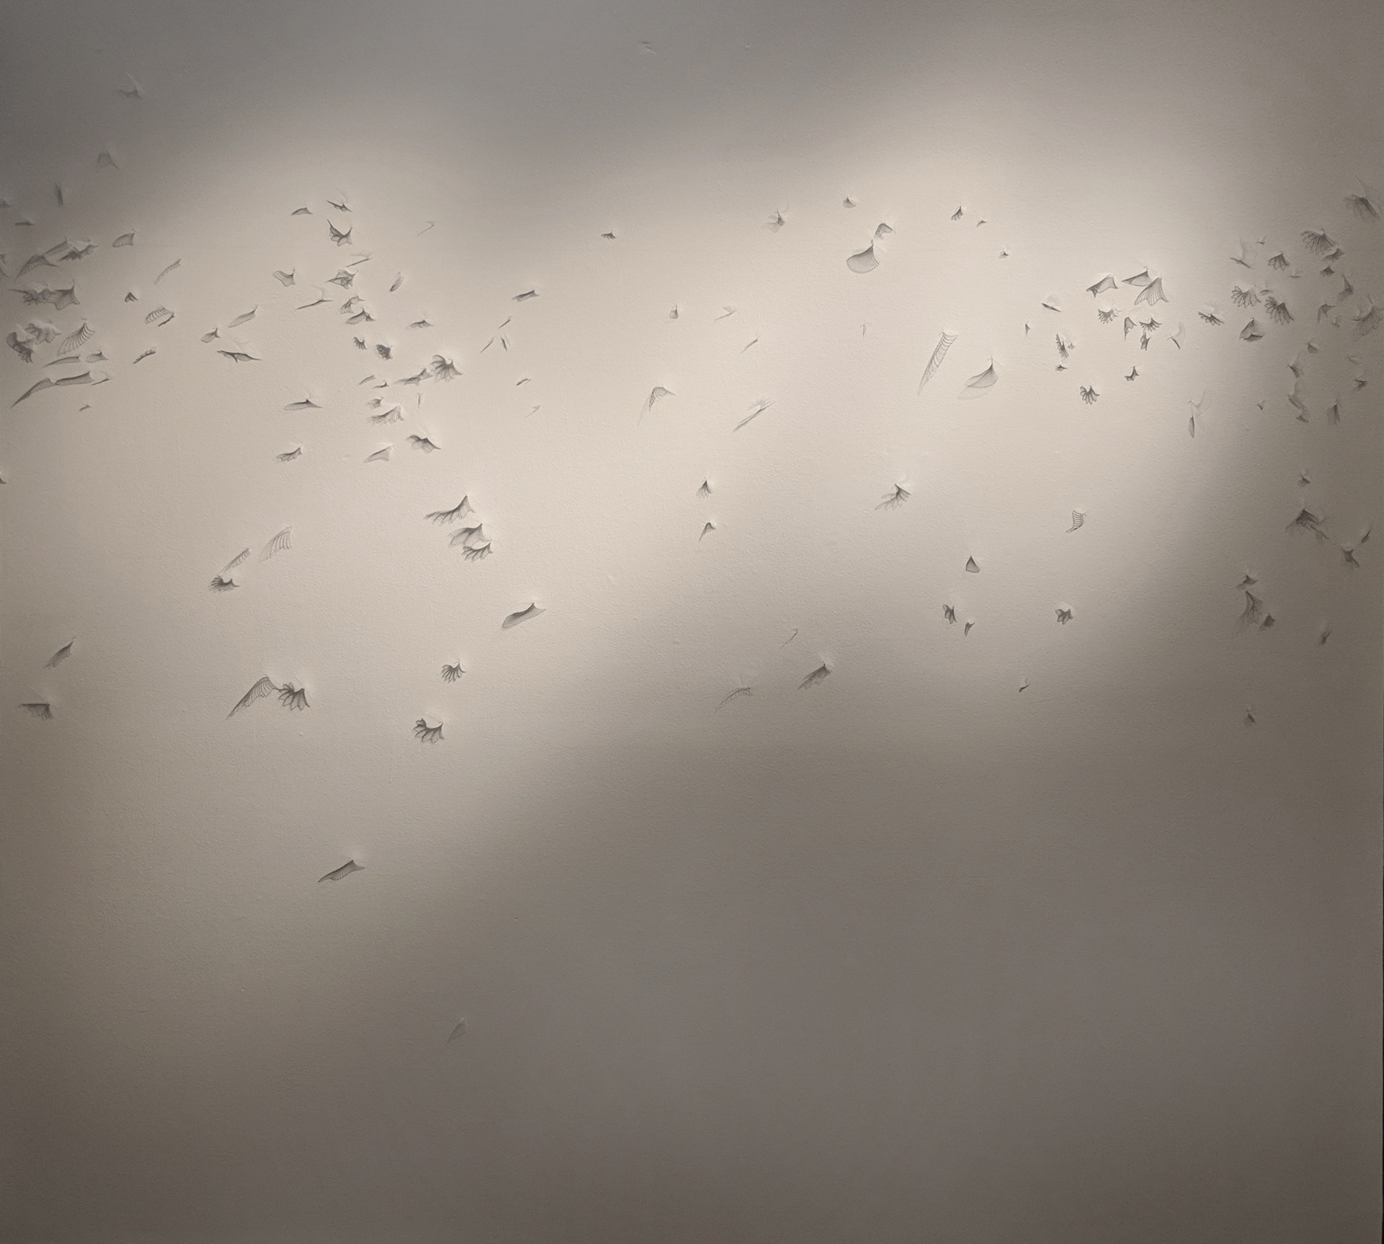
Molly Morin, Migrating, Separated, 2018

Slide 14
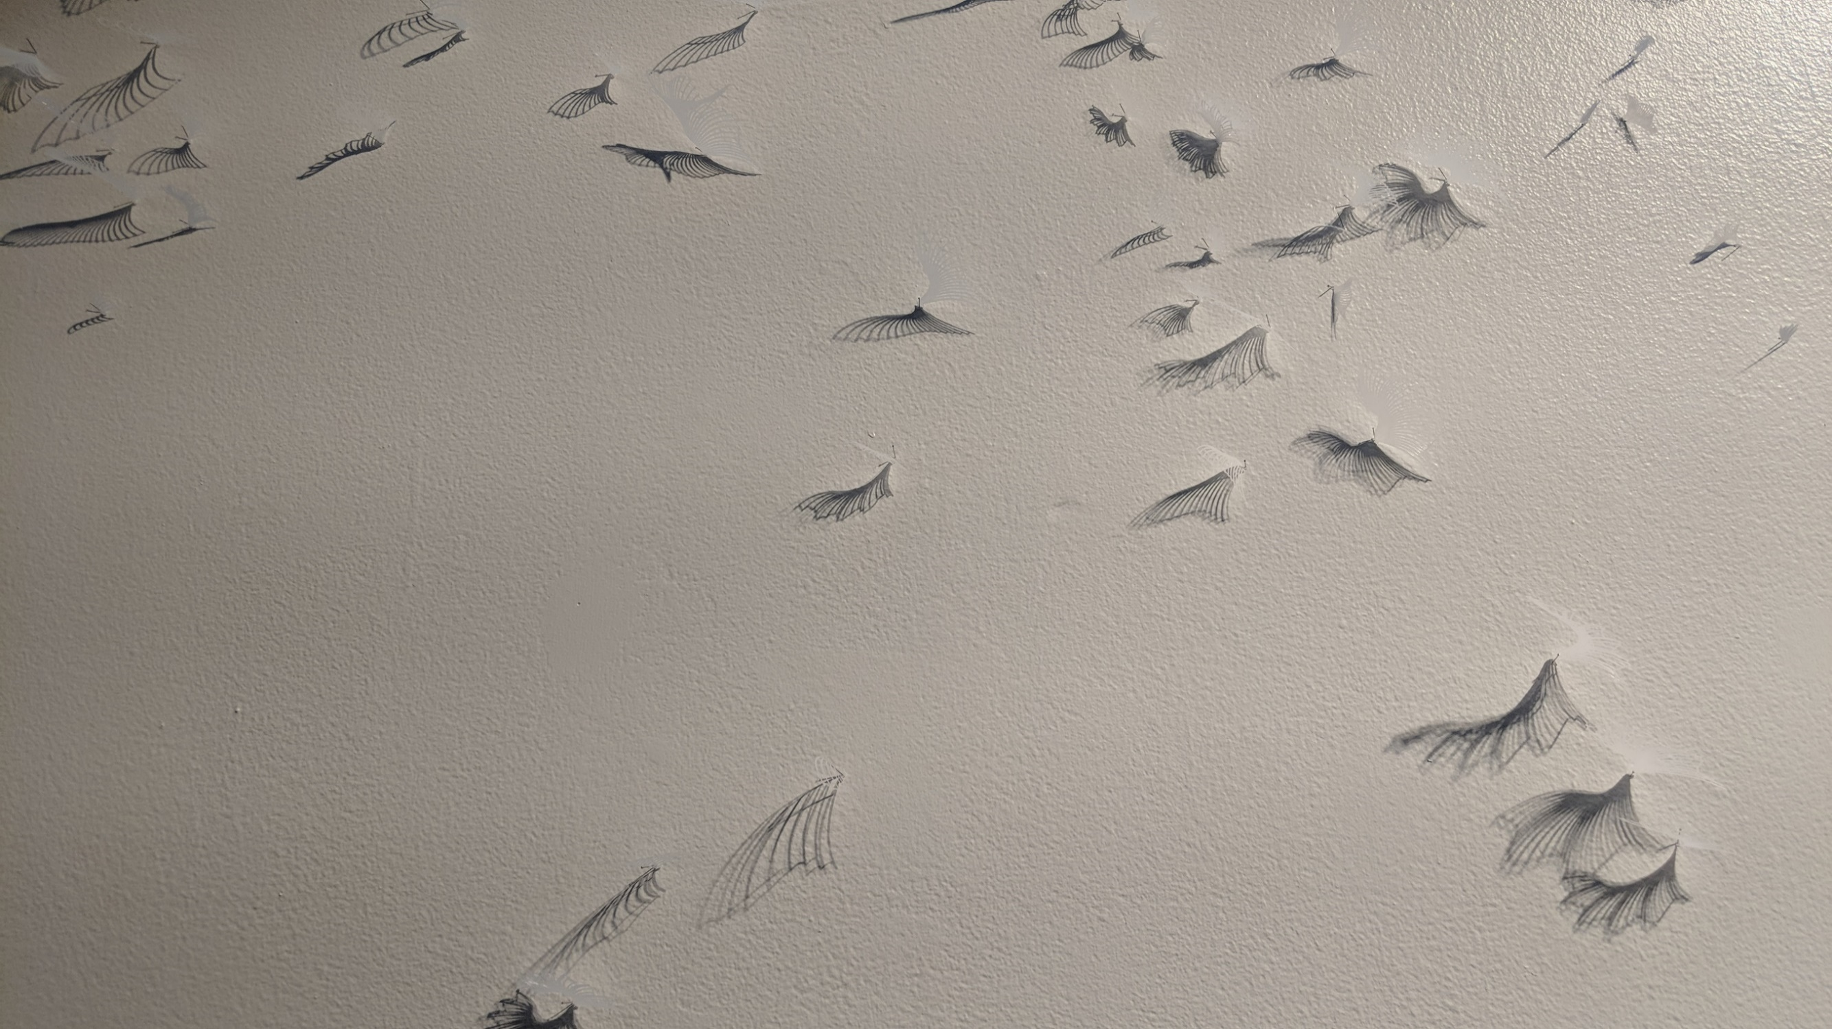
Molly Morin, Migrating, Separated, 2018

Slide 15
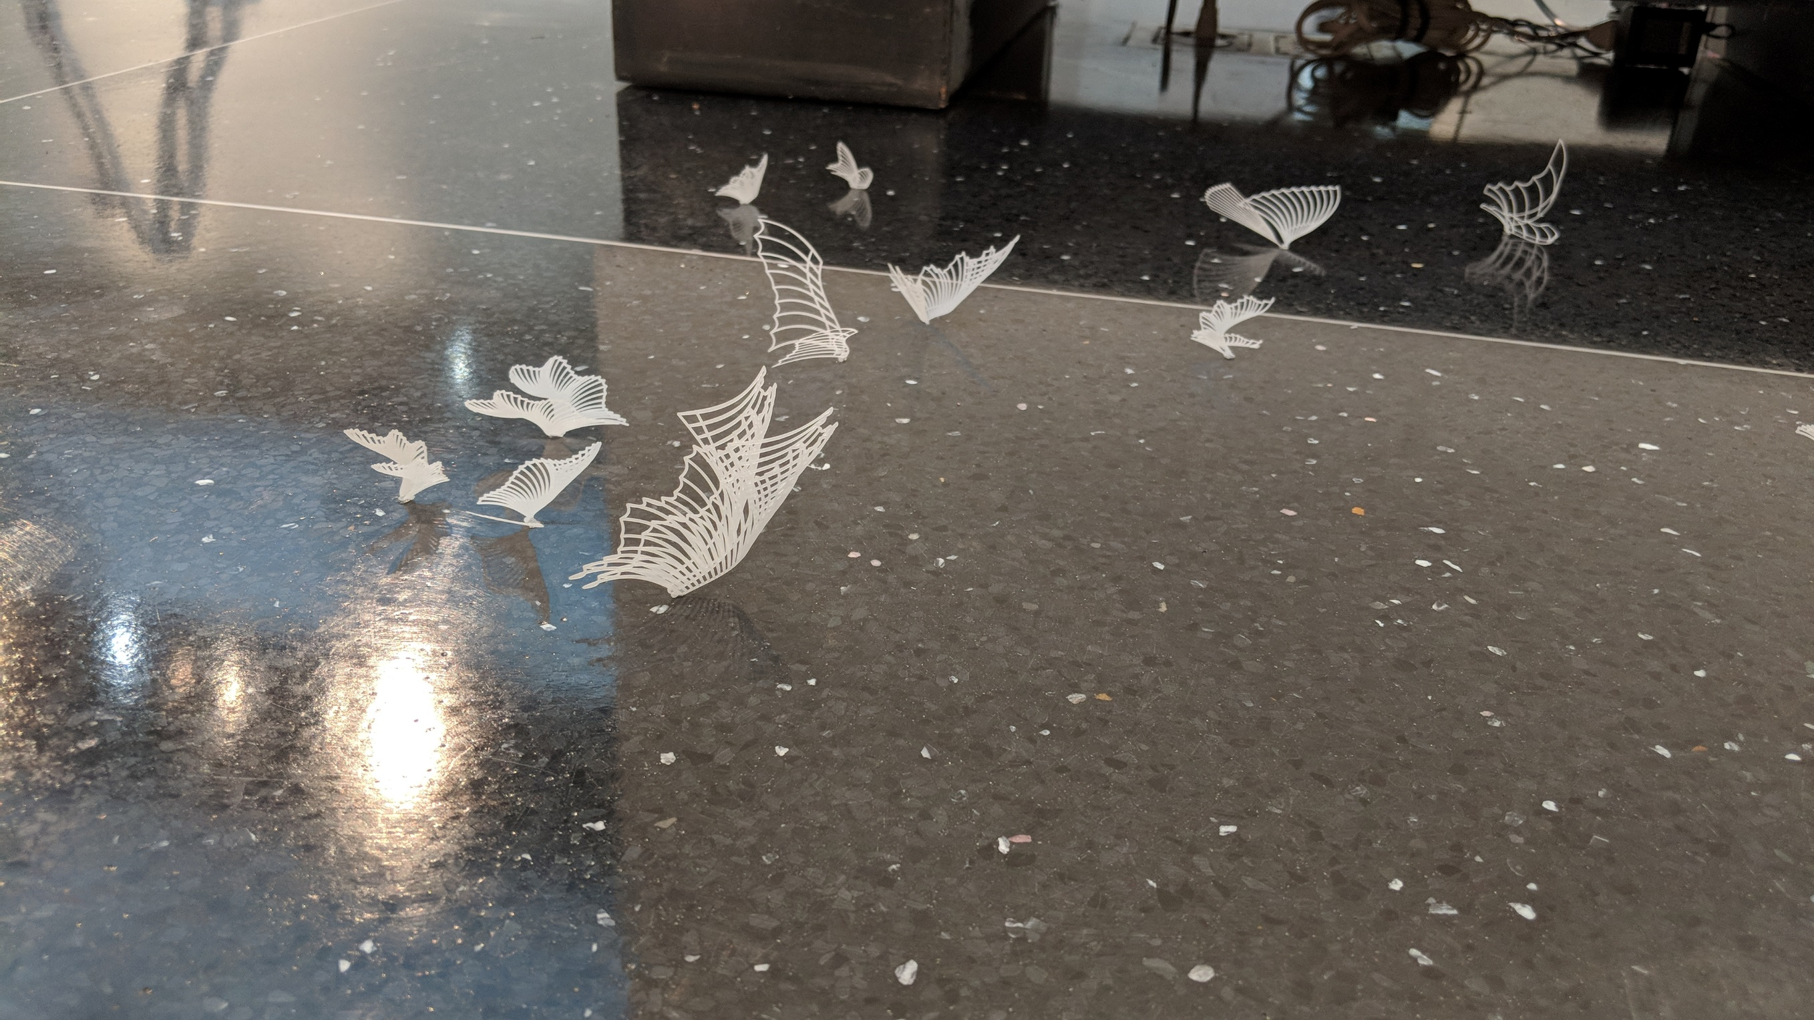
Molly Morin, Migrating, Separated, 2018

Slide 16
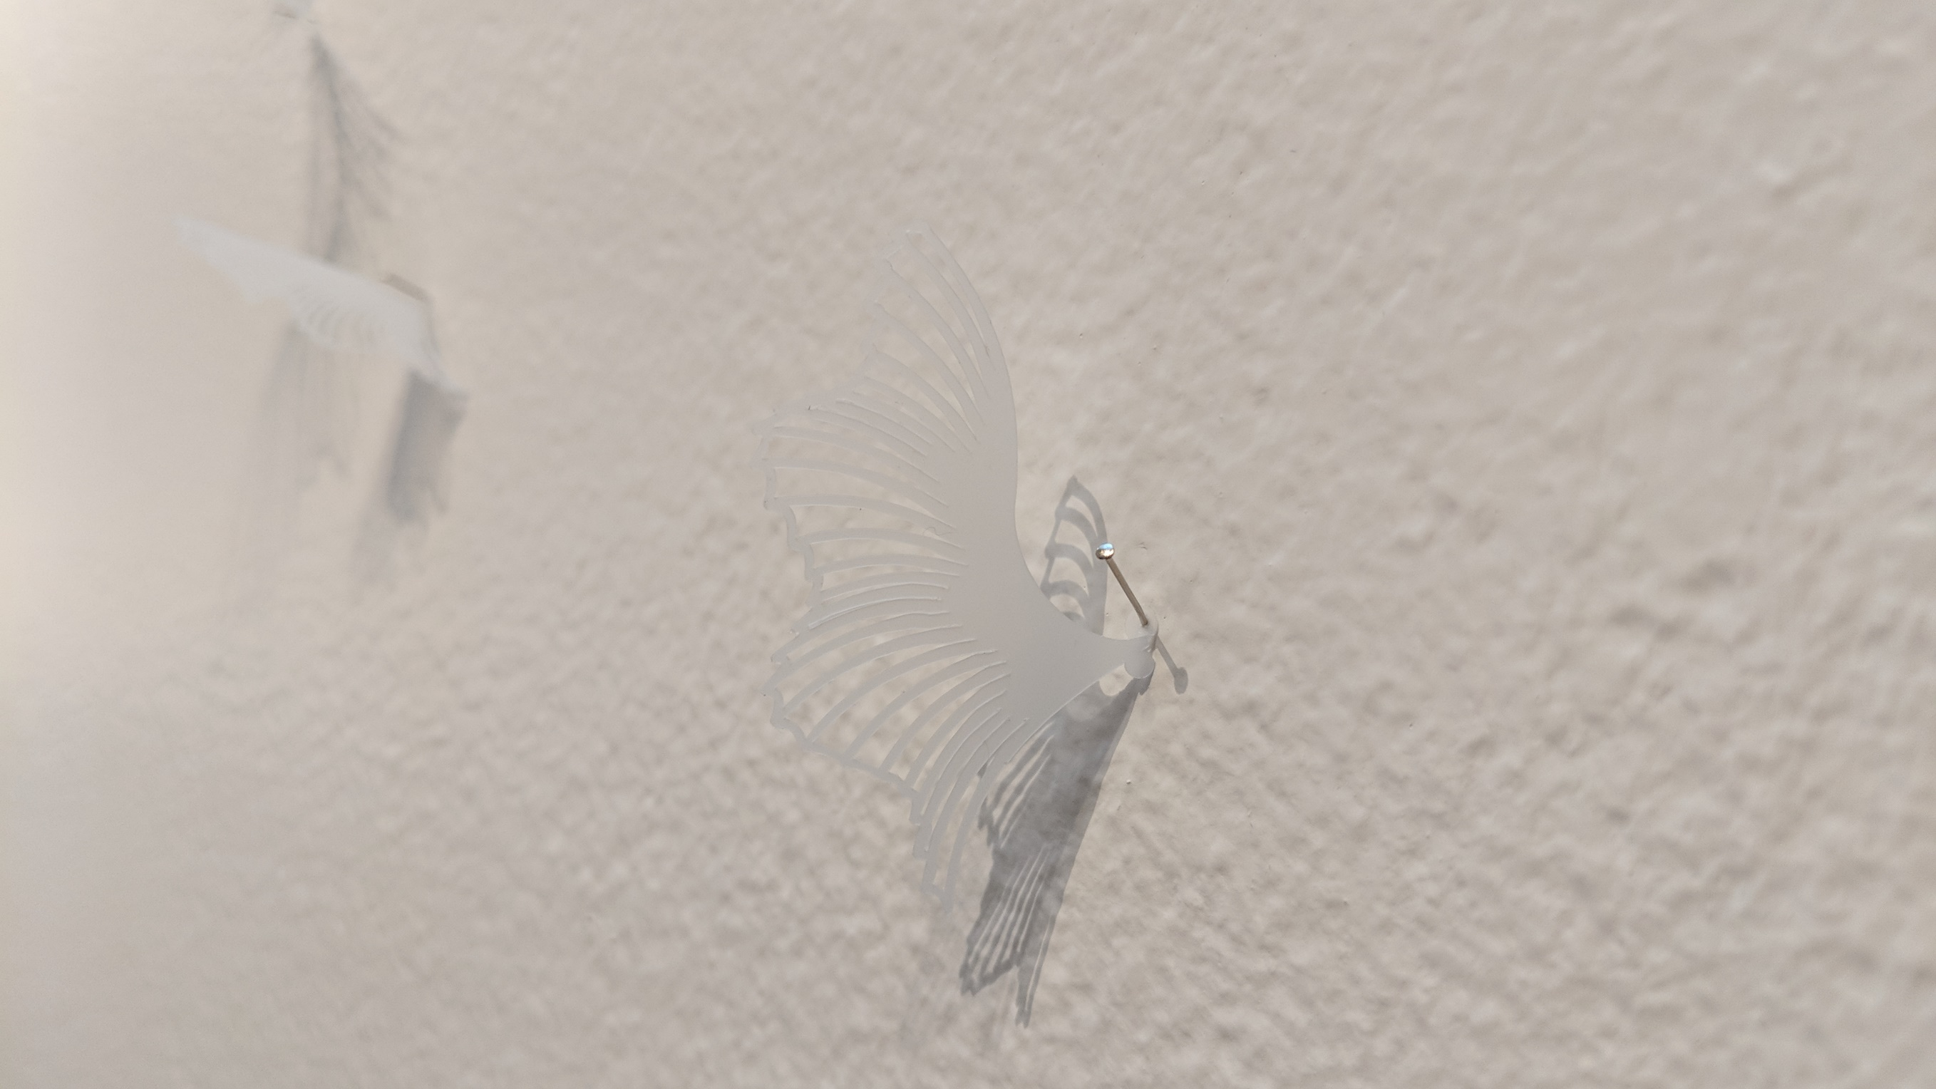
Molly Morin, Migrating, Separated, 2018

Slide 17
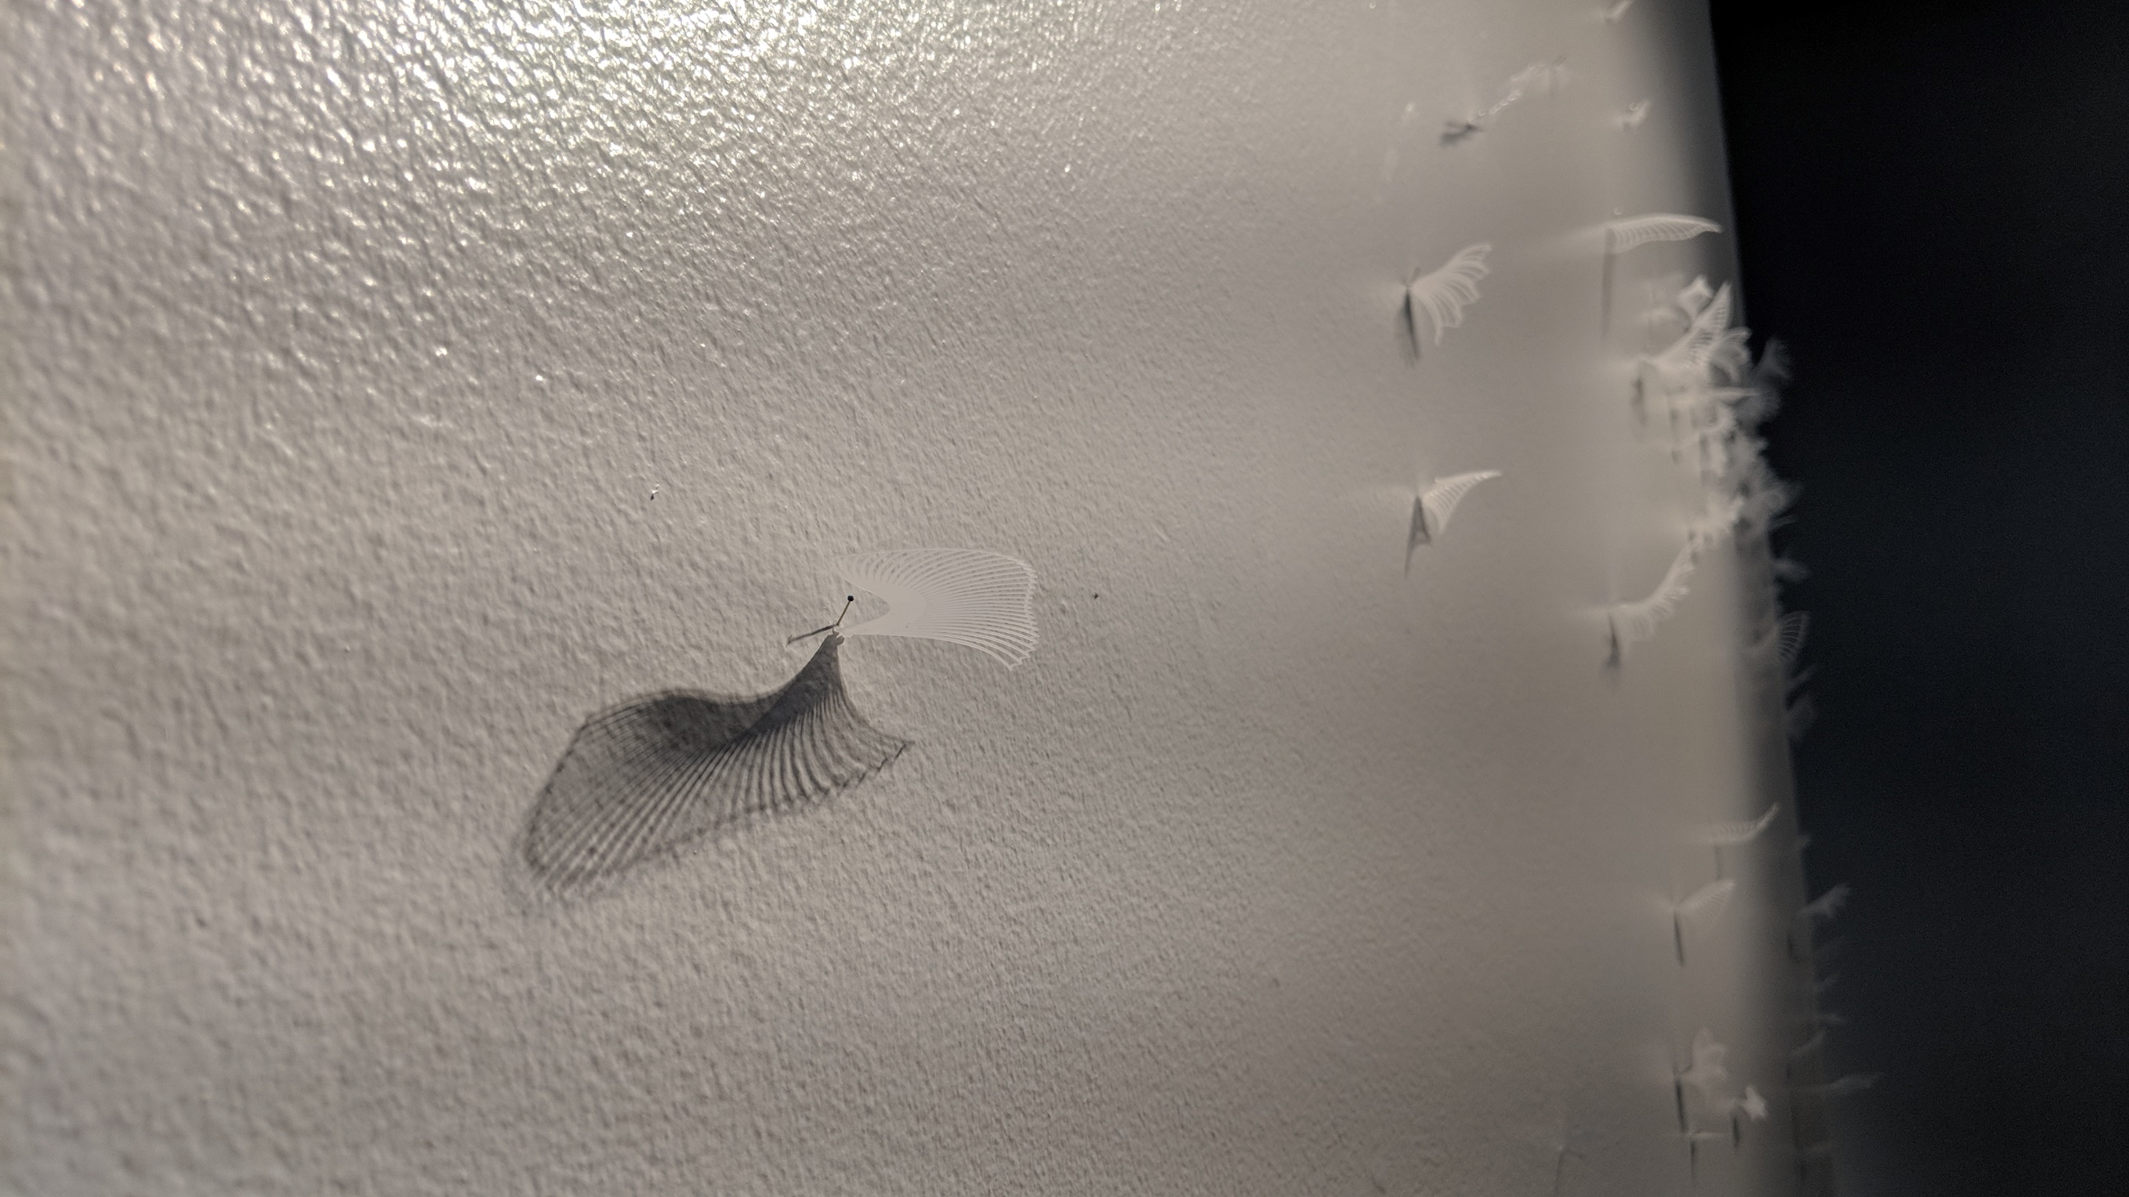
Molly Morin, Migrating, Separated, 2018

